Slide 1
Gender Advisory Support to CSUD Project
Natalija Ostojić
UN Women

Slide 2
Gender Equality and Climate Change?
Gender roles and other identities affect our vuknerability to climate change consequneces (be it physical, health, economical or social ones).
Climate change as a threat to human rights and equalities particularly gender equality.
A framework of activities to support the work of the Ministry of Environmental Protection on the gender mainstreaming of climate smart actions.

Slide 3
Gender Aspects of Climate Change
Women are at a higher risk of poverty, have fewer resources, are less employed, have lower income
Women perform most household tasks and are more dependent on the availability of water and energy
There is less women among engineers, employees and managers in the field of energy
Women use public transport more often
WOMEN AS AGENTS OF CHANGE

Slide 4
Therefore...
UNFCCC Decision 3/CP23 on Establishing Gender Action Plan
Inclusion of women in decision making
Gender seggregated indicators
Gender analysis of actions, measures and policies
Gender responsive budgeting
Gender Sensitive Reporting

Slide 5
UN WOMEN Advisory Services
Ensuring gender mainstreaming of the processes and results of the two CSUD Challenges – Open Data and Innovation Challenge through:
Increasing the knowledge and skills of civil servants, representatives of NGOs and community groups to incorporate gender considerations into both challenges; and
through reflecting differentiated impact of proposed actions to men and women.

Slide 6
UN WOMEN Advisory Services, cont.
Development of gender-sensitive criteria through the elaboration of two documents:
Frequently Asked Questions: Gender Equality and Climate Change;
Gender Annex to the set of application documents within the Innovation Challenge for Mature Project Ideas – Analysis of Project Impact on Local Communities, Women and Men

Slide 7
Outreach Campaign
Organized total total 9+1 outreach events:
Inaugural conference followed by networking event held in the Belgrade City Assembly;
Five Forums held in four regions of Serbia;
Two specific mentoring sessions;
Two general public advocacy events.

Slide 8
Mentoring Support
The initial expert analysis with set of recommendations for gender mainstreaming;
Sectoral analysis and recommendations (energy-related projects, waste-related projects, green-space related projects, and urban-mobility related projects);
Final report: Five Case Studies.
Ensuring that the Ministry has a clear overview of existing practices of mainstreaming gender into climate policies, plans and actions and that it shall lead to the proposal of a set of recommendations for further improvement of the Ministry’s work in the area, including for the UNFCCC reporting purposes (in line with respectful Decisions of the UNFCCC CoP23).

Slide 9
Capacity Building
Increasing the capacities of the civil servants and national and municipal gender equality mechanisms on the gender dimension of the climate change resilience and adaptation through developing curricula on gender and climate change and organization of a training.

Slide 10
Capacity Building, cont.
Three-day training on gender aspects of climate change for representatives of ministries, local self-governments and non-governmental organizations (June, 2018);
Tools for introducing a gender perspective; ideas for incorporating gender aspects into policies and projects;
Increase in knowledge by 30%; new angle of viewwing the topic;
Women's participation in activities; economic empowerment of women - women's entrepreneurship; education and improvement of knowledge and awareness of climate change, etc.
Training handbook with a review of documents, tools, key gender aspects, and a guide to include a gender perspective into policies and measure.

Slide 12
Gender and Climate Change: Training Handbook
Aims to enhance understanding and give information about:
Understanding gender roles, gender stereotypes and their influence on the creation and results of public policies and measures, and vice versa, the possibility of changing gender relations and the position of women and men through public policies;
Gender issues relevant to activities and policies in the field of response to climate change effects;
Activities that can be taken to introduce gender perspective into policies and programs in the field of climate change.

Slide 13
Gender and Climate Change: Training Handbook
Basic concepts, gender roles and stereotypes;
Key Gender Aspects of Climate Change;
Legal and Strategic Framework;
Introduction of the Gender Perspective in Policies and Programs.

Slide 14
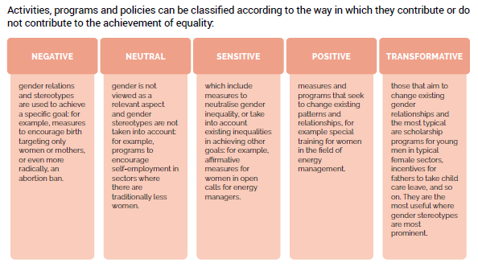

Slide 15
Training evaluation
Interactive approach, with a lot of open discussions, engagement and their involvement;
The importance of concrete and practical examples and clear presentations, interaction, team work in small groups, new perspectives and approach;
Regarding the content, participants liked the most the session on gender and public policies, gender mainstreaming and gender responsive budgeting.
In additional comments participants shared their impressions on the training as very good, “the best they have ever attended” and highlighted the need for additional trainings and support to work on the set goals.

Slide 16
Thank you for your attention! Natalija Ostojic Gender Mainstreaming Associate UN Women Email: natalija.ostojic@unwomen.org

